Slide 1

Predictive Analysis of salary For Different Job Titles
NEW YORK CITY
GROUP C
Shanmathi Arul Ashwin Karthik
Kaushik Sridharan
Mentor - Dr. Jongwook Woo

Slide 2
Contents
Introduction
Objective
Pre-requisites
Feature Selection
AzureML Model Building
Azure Result Comparison
References
SparkML process flow
SparkML Model Building
Result Comparison- AzureML Vs SparkML
Summary
Limitations & Problems Faced

Slide 3
Introduction
The dataset contains various jobs filings in New York City
Some of features are as follows:
Job ID
Hours/Shift
Agency
Part-Time and Full Time Indicator
Business Title
Salary

Slide 4
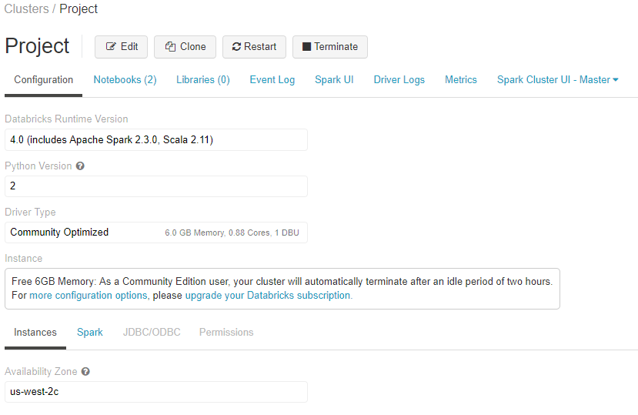
Hardware Specification
Apache Spark Version – Spark 2.3.0 (Scala 2.11)
Memory – 6GB Memory, 0.88 Cores, 1 DBU
File System – DBFS (Data Bricks File System)

Slide 5
Dataset Information
Dataset Name –Job Application filings
Dataset Format – Comma Separated Values (CSV)
Dataset Size – 2.7 GB
Dataset Source - https://data.cityofnewyork.us/Housing-Development/DOB-Job-Application-Filings/ic3t-wcy2

Slide 6
Objective and Algorithms
The aim of our project is to predict the Salary of an employee based on the available features from the dataset by utilizing Machine learning Algorithms and build accurate models using AzureML and SparkML.
Machine Learning Algorithms used in this project:-
Boosted Decision Tree Regression
Linear Regression

Slide 7
Pre-requisites
AzureML account.
Databricks Community Edition account
Knowledge of Machine Learning Algorithms.
Knowledge of AzureML, SparkML and Python.

Slide 8
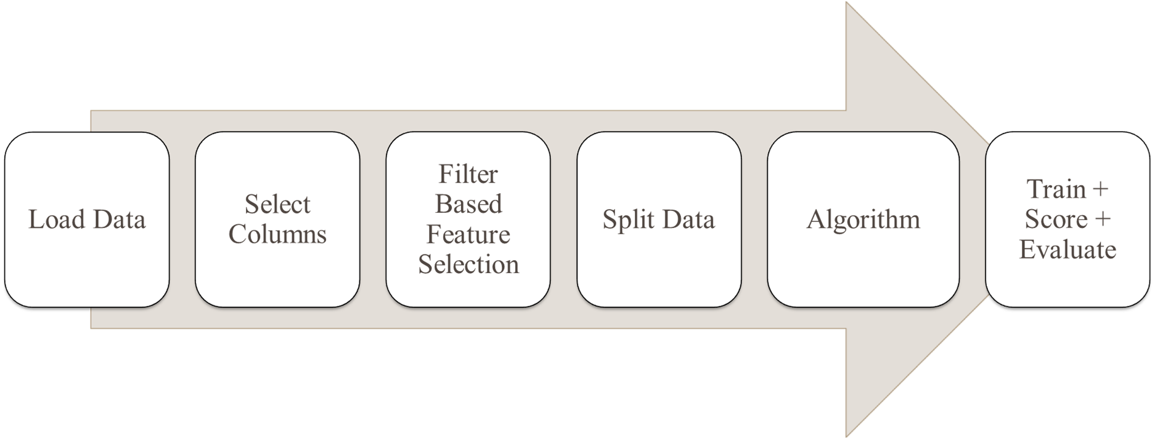
AzureML Model Building - Regression

Slide 9
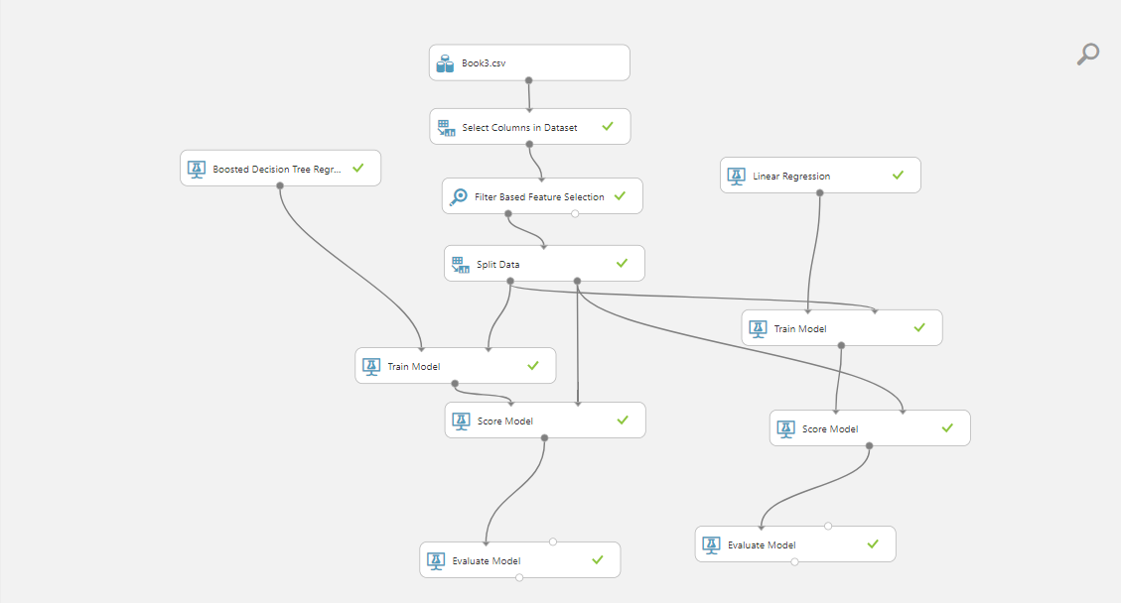
Model

Slide 10
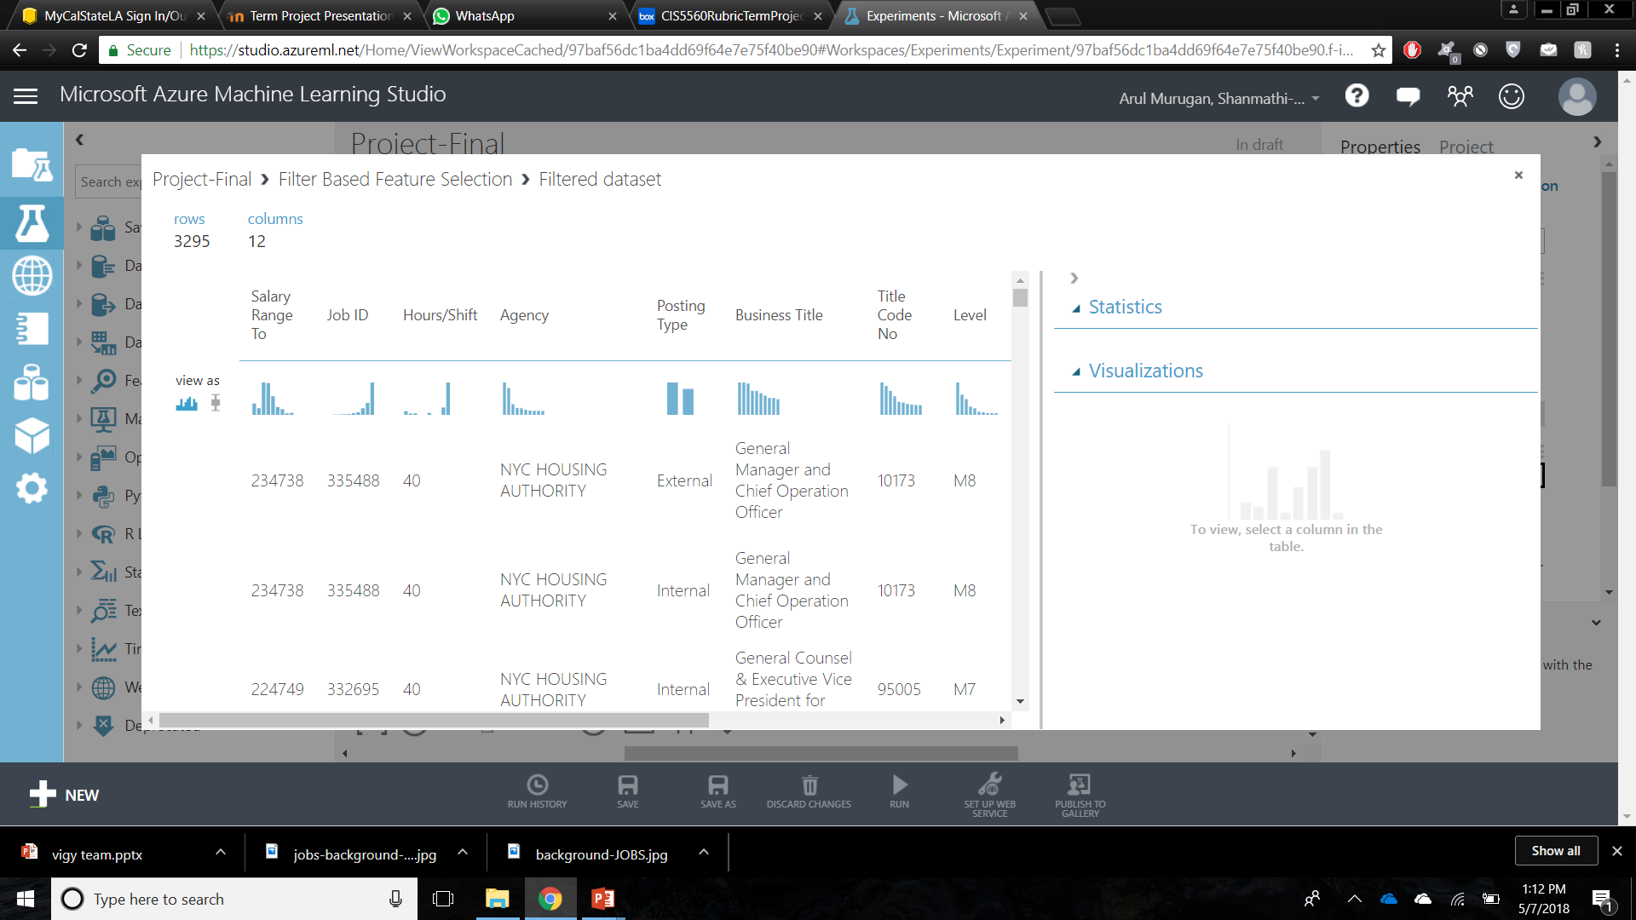
Filter Based Feature Selection
These are the best feature that can be used:

Slide 11
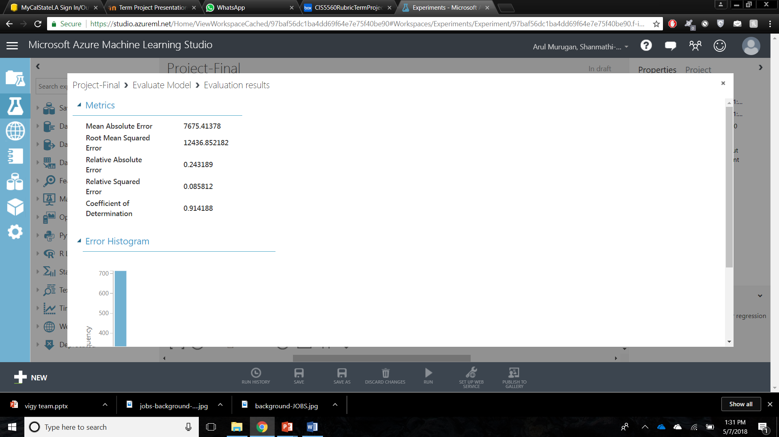
Boosted Decision Tree Regression Result:
Columns: SalaryRangeTo, JobID , Hrs/Shift, Agency Posting Type, Business title , Title code ,Level, Job Category, FullTime/PartTime Indicator, Salary Frequency, Work Location

Slide 12

Linear Regression Result :
Columns Used : SalaryRangeTo,JobID Hrs/Shift,Agency Posting Type, Business title , Title code ,Level,Job Category,FullTime/PartTime Indicator,Salary Frequency,Work Location

Slide 13
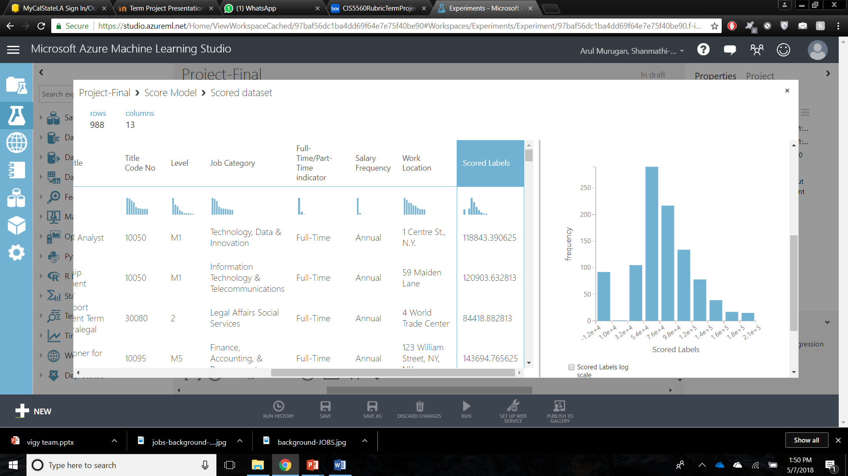
Boosted Decision Tree Regression

Slide 14

Linear Regression

Slide 15
Azure Result Comparison
Boosted Decision Tree Regression :
RMSE= 12436.852182
COD= 0.914188
1
Linear Regression:
RMSE= 9961.10068
COD= 0.944952
2
From the above result comparison, we have found that Simple Linear Regression is the best method for prediction of salary with the features predicted from this data set

Slide 16
SparkML process flow
Load Data
Import Spark Libraries
Feature Extraction
Split Data
Transform/Test
Fit/Train
Cross Validator
Algorithm
Evaluator

Slide 17
Spark ML - Regression
Regression Models
Algorithms Used: Gradient Booster Tree Regression
Linear Regression
Features Used: Job_ID, Posting_Type , Title_Code_No, Level, Hours_Shift FullTime_PartTime, Salary_Frequency
Label Predicted: Salary_Range_To
Evaluation Metric: Root Mean Squared Error
Split – 70% for Train Data and 30% for Test Data

Slide 18
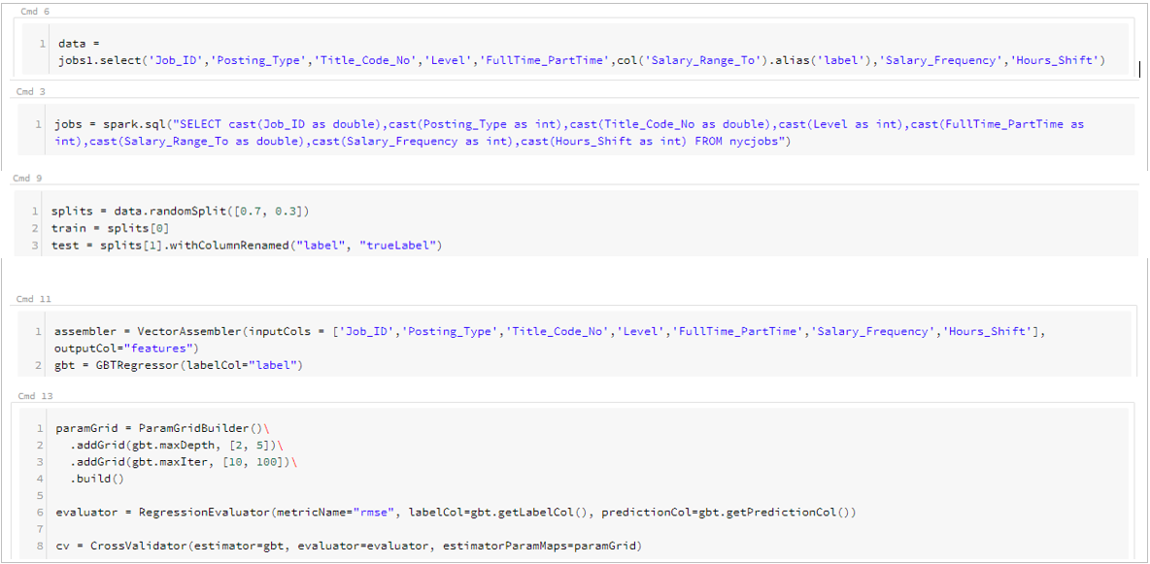
Spark ML Code Snippet Overview

Slide 19
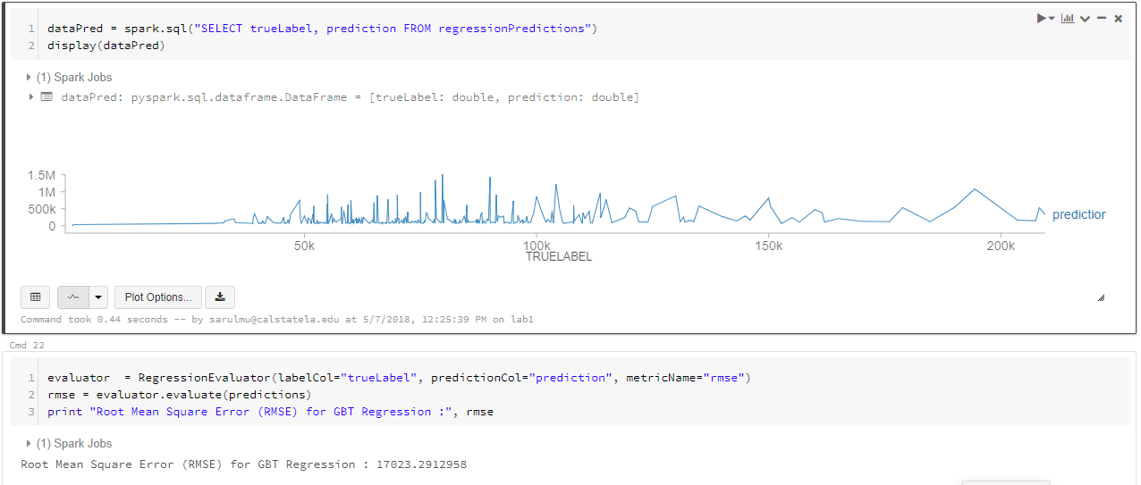
Gradient Boosted Tree Regression
The Root Mean Square Error (RMSE) using Gradient Boosted Tree Regression Algorithm is 17023.2912958

Slide 20
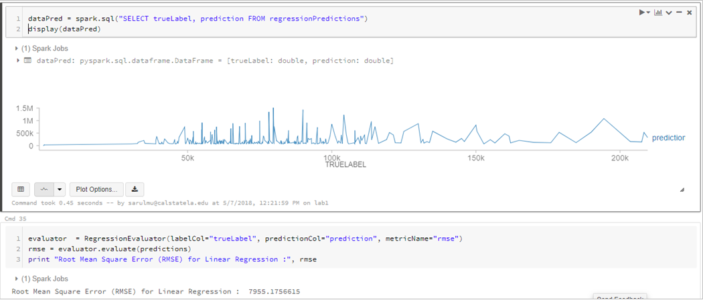
Linear Regression
The Root Mean Square Error (RMSE) using Linear Regression Algorithm is 7955.1756615

Slide 21
Spark Result Comparison
Gradient Boosted Tree Regression :
RMSE= 17023.2912958
1
Linear Regression:
RMSE= 7955.1756615
2
From the above result comparison, we have found that Linear Regression is the best method for prediction of salary with the features predicted from this data set

Slide 22
Result Comparison : AzureML vs Spark ML
Azure ML |  | Spark ML
Boosted Decision Tree Regression | Linear Regression | Gradient Boosted Tree Regression | Linear Regression
RMSE=12436.852182 | RMSE=9961.10068 | RMSE=17023.2912958 | RMSE=7955.1756615

Slide 23
Summary
Based on selected features predictive analytics was conducted to predict the salary of different job titles in New York city
Comparing the different machine learning models between AzureML and SparkML , Linear Regression in Spark ML predicted the best results.

Slide 24
Limitations
Feature prediction was much easier in AzureML than that of SparkML
If the data set has more details such as work experience , skill set etc., we could have predicted more accurate salary for different job titles, because the employee may be a fresher or an experienced candidate.

Slide 25
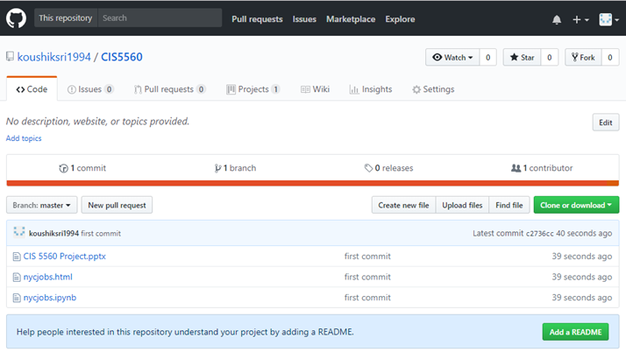
GitHub
https://github.com/koushiksri1994/CIS5560

Slide 26
References
https://www.analyticsvidhya.com/blog/2017/09/common-machine-learning-algorithms/
https://people.apache.org/~pwendell/spark-nightly/spark-master-docs/latest/ml-classification-regression.html
https://github.com/apache/spark/tree/master/examples/src/main/python/mllib

Slide 27
Thank You

